Slide 1

THEORIES OF LEADERSHIP LEADING TEAMS
SPRING 2023
CHAPTER 10
FAREED QURESHI

Slide 2

CHAPTER OBJECTIVES
Turn
Turn a group of individuals into a collaborative team that achieves high performance through shared mission and collective responsibility.
Develop and apply
Develop and apply the personal qualities of effective team leadership for traditional, virtual, and global teams.
Understand and handle
Understand and handle the stages of team development, and design an effective team in terms of size, diversity, and levels of interdependence.
Handle
Handle conflicts that inevitably arise among members of a team.

Slide 3
TEAM
A unit of two or more people who interact and coordinate their work to accomplish a shared goal or purpose

Slide 4
STAGES OF TEAM DEVELOPMENT
FORMING
Orientation, break the ice,
STORMING
Conflict, disagreement
NORMING
Establishment of order and cohesion
PERFORMING
ADJOURNING
Leader: Encourage participation, surface differences
Leader: Facilitate social interchanges
Leader: help clarify team roles, norms, values
Cooperation, problem solving
Leader: Facilitate task accomplishment

Slide 5
EVOLUTION OF TEAMS AND TEAM LEADERSHIP
Cross-Functional Team
Coordinates across organization boundaries for change projects
Leader gives up some power
Special purpose team, problem-solving team
Functional Team
Grouping individuals by activity
Leader centered
Vertical or command team
Self-Directed Team
Autonomous, defines own boundaries
Member-centered
Self-managed team
Need for traditional leadership Need for team leadership

Slide 6
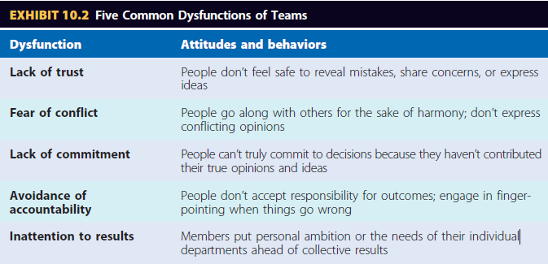
THE DILEMMA FOR TEAM MEMBERS
We have to give up our independence.
We have to put up with free-riders.
Teams are sometimes dysfunctional.

Slide 7
LEADING A TEAM TO HIGHER PERFORMANCE
A compelling purpose, clear objectives, and explicit metrics.
A diversity of skills and unambiguous roles.
Streamlined team size.
Decision authority over how to achieve goals.
Support and coaching

Slide 8
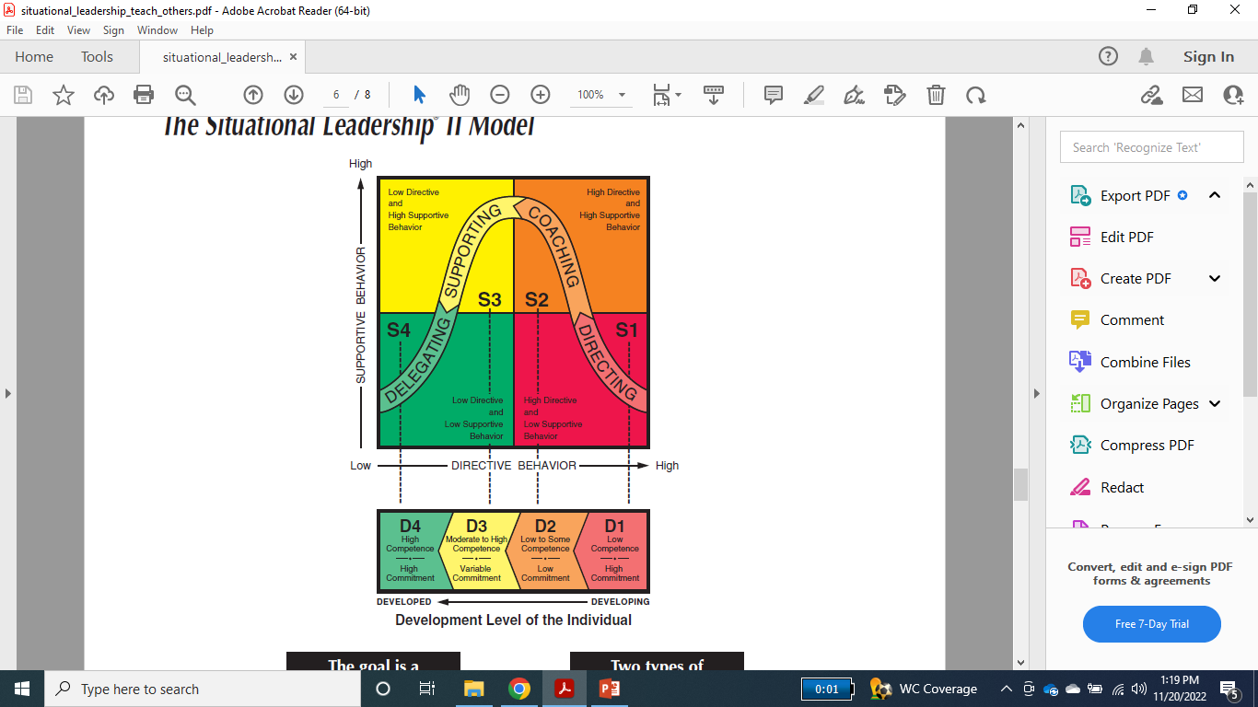

Slide 9
LEADING EFFECTIVE TEAMS
Team effectiveness: the extent to which a team achieves four performance outcomes: innovation/adaptation, efficiency, quality, and employee satisfaction
Team cohesiveness: the extent to which members stick together and remain united in the pursuit of a common goal
Determinants of Team Cohesiveness
Team interaction
Shared goals
Personal attraction to the team
Presence of competition
Success and Positive evaluation by outsiders

Slide 10
ESSENTIAL TEAM COMPETENCIES
Goal setting and performance management
Planning and coordination
Collaborative problem solving
Communication
Conflict resolution

Slide 11
TEAM MEMBER ROLES
Task-Specialist Role
Initiate ideas
Give opinions
Seek information
Summarize
Energize
Socio-Emotional Role
Encourage
Harmonize
Reduce tension
Follow
Compromise

Slide 12
DIFFERENCE BETWEEN CONVENTIONAL, VIRTUAL AND GLOBAL TEAMS
Type of Team | Spatial Distance | Communications | Member Cultures | Leader Challenge
Conventional | Colocated | Face to face | Same | High
Virtual | Scattered | Mediated | Same | Higher
Global | Widely scattered | Mediated | Different | Very high

Slide 13
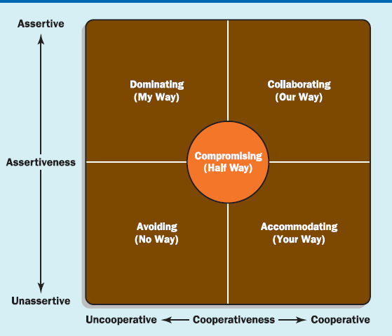
CONFLICT MANAGEMENT STYLES

Slide 14

THAT IS ALL FOR TODAY!!

